Slide 1
SQM & CAS Status Report
C. Johnson & Tom Larason, NIST
MOBY NET
June – Present, 2015

Slide 2
Introductory slide on the Satellite Quality Monitor (SQM) from Yankee Environmental Systems (YES).

Slide 3
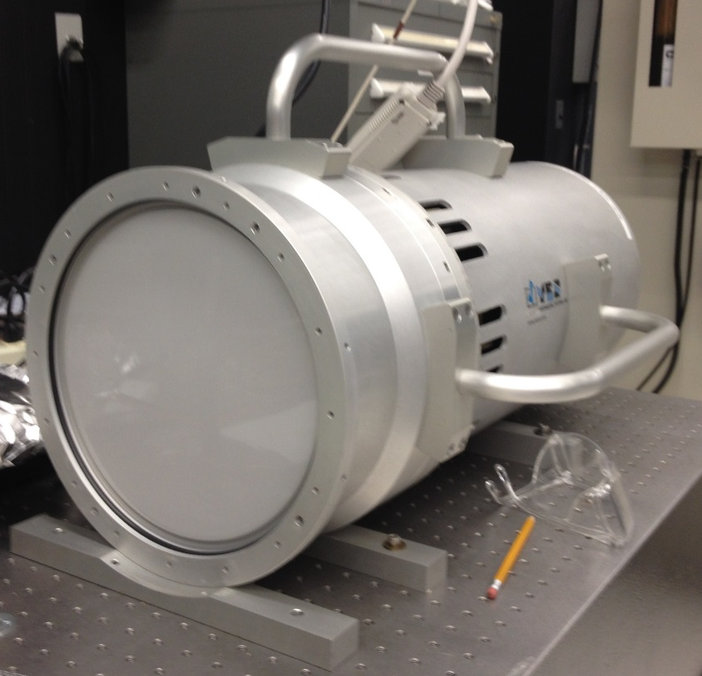
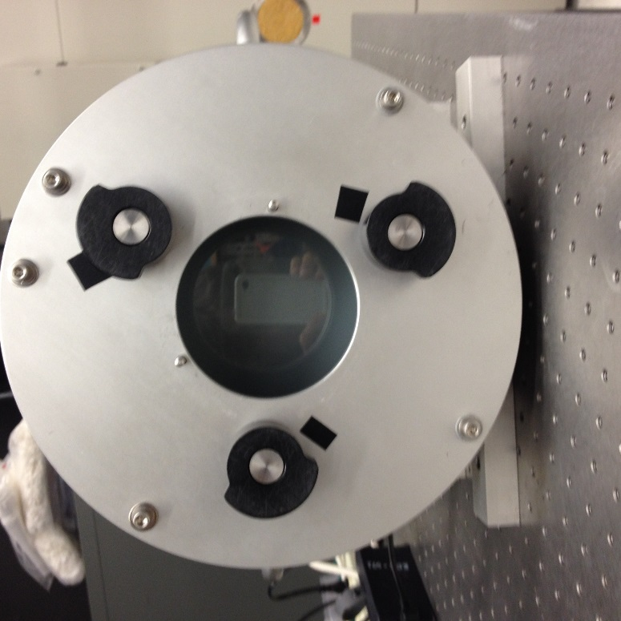
The SQM arrived at NIST on TBD; it shipped from U. Miami to NIST immediately after its delivery in Miami. As shown, the front window is removed and the diffuser is in place. O-rings secure these optical parts from movement and protect the lamp chamber from ambient environment.
SQM with the Device Under Test (DUT) flange and light-tight spacer attached. The central hole is the OD of the DUT to be assessed (e.g. a Satlantic OCR). A mounting ring would be attached to the outside cylinder of the OCR, set back from the front a defined distance, and with two holes for the mating pins. Thus the distance to the SQM front plate and the azimuthal angle are invariant for each OCR testes. The black knobs lock the OCR in place.
We will make DUT flanges and light tight spacers for MOBY NET foreoptics and the CAS monitoring radiometer.

Slide 4
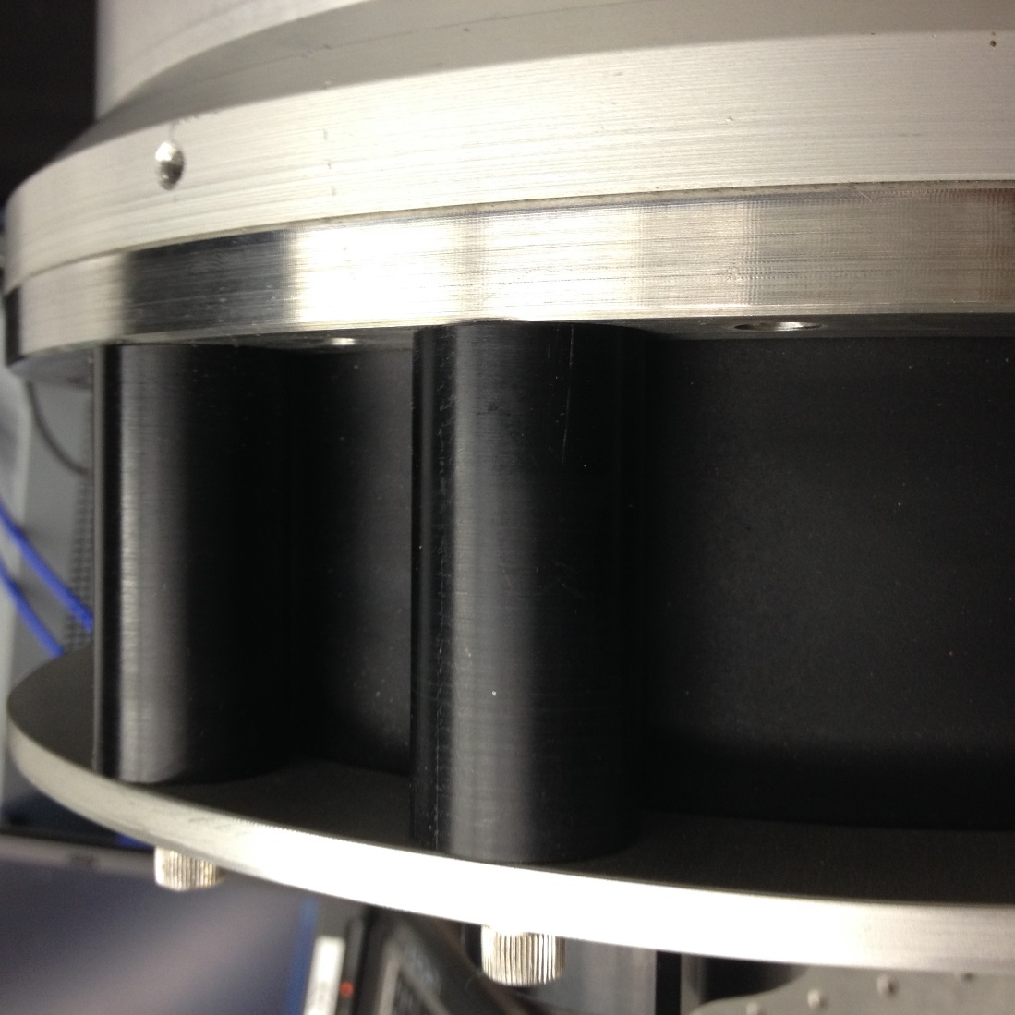
Side views of SQM with the YES mounting plate installed. The is a black spacer ring makes the chamber between the front of the mounted DUT and the exit aperture of the SQM light tight.
These parts were measured by the NIST shops and the dimensions sent to MLML so they can make the adaptors for MOBY NET. NOTE: the CMM machine is down and the dimensions were determined using hand tools. The tolerances were stated as ±0.005”.

Slide 5
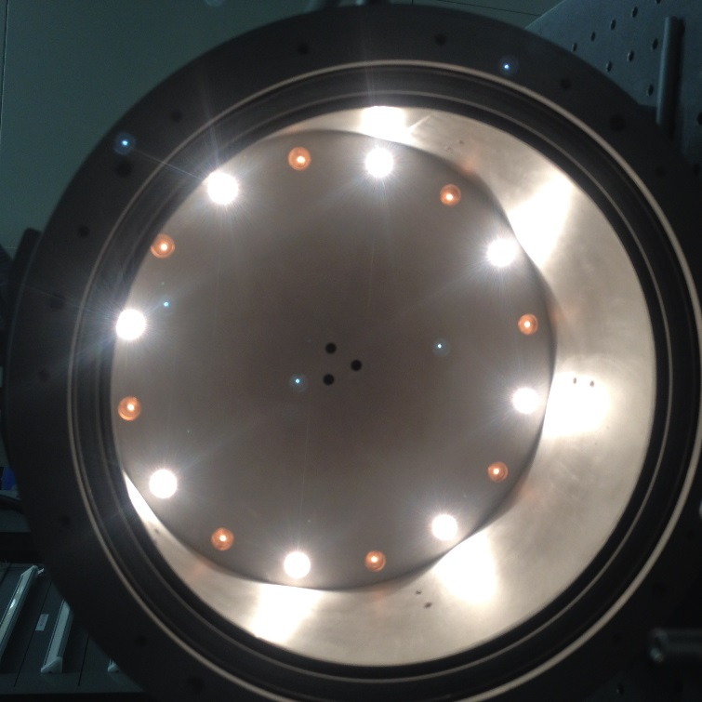
There are two lamp sets, Set 1 and Set 2. Each set has 8 identical lamps. The two sets differ in lamp current. TBD look up original lamp specs and make a table.
SQM with front window and diffuser plate removed. One lamp set is on, the other is warming up. The three holes in the center of the back plate allow for three silicon photodiodes to measure the flux looking at the back side of the diffuser. The interior walls are bead-blasted aluminum.
The two lamp sets are operated as
HI = both Sets on
MED = high current Set on, low current Set off
LO = high current Set off, low current Set on
The three PDs are
filtered (blue)
filtered (red)
unfiltered

Slide 6
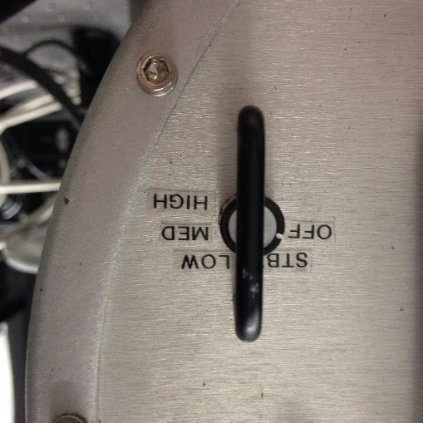
The SQM runs stand alone, the operator manually switches between states. Note “off” is not off, fans are still running. I’m using a power strip as the final on/off switch. This means careful and accurate Log Sheets will be required. YES replaced the external control system in the NIST design with an embedded processor – an 6812 microprocessor running FORTH.
As an option, a Labview executable called “SQM Manager” will log instrument housekeeping data. As delivered, the software on the CD, indicated for a Win XP 32 bit operating system, would not install on an obsolete* NIST PC running Win XP Prof Ver 2002 SP3. It had a missing or incompatible piece of software – the message was “An installable Virtual Device Driver failed DLL initialization, choose Close or Ignore”. Selecting Ignore installed SQM Manager but it would not talk to the device. This was June. During the time it took to make progress on this issue, I decided to take some test data with a NIST CAS, the UV CAS (200nm to 870nm).
*Obsolete because NIST mandates they cannot be connected to the Internet; we have replaced all computers with Win 7 operating systems. I have one old XP machine for testing, but it cannot be updated. Repairs will be difficult to procure.

Slide 7
On July 7 the SQM was run manually, without SQM Manager, to assess the three levels. I also measured a Hg penlamp to be sure the UV CAS indeed measured UV. For these CAS tests, I’m using NIST custom software most recently modified by John Woodward. This is not the final version of the MOBY NET CAS software; more work needs to be done.
On July 8 and 14, I measured the output with the window and diffuser, just the diffuser, just the window, and bare lamps to assess the UV transmittance of the front diffuser and window. The diffuser is plastic and the window is glass. As a test of what a quartz diffuser would look like, I placed a 1” diameter ground quartz sample in front of the CAS input fiber.
All results were normalized to 450.4nm. The bottom line is to get to 350nm, we need to replace the plastic diffuser and the glass window with fused silica (quartz).
Origin graph.

Slide 8
I took the window and diffuser to the NIST shops and had them measured. The same caution applies – the CMM machine is down so Wendell used calipers.
Diffuser: 9.375” +/- 0.005” diameter, 0.114” (actual) thick
Window: 9.914”+/- 0.005” diameter, 0.370” (best vendor effort) thick.
The NIST Optics Shop (Aaron Kirchhoff) recommended GM Associates, Oakland, CA, as a supplier of custom fused silica in these sizes. GM Associates recommended GE124, which has >90% transmittance at 10mm thickness from 300nm to 2500nm. Two windows ($300 each) and six diffuser blanks ($200 each) were ordered. The windows will have a commercial grade polish. The GM procedure for roughening is to provide a 32 microinch roughness. We evaluated a sample, which was partially transparent, and decided we could do better (see next slide). So the diffuser parts were also specified to have the commercial grade polish, and we will finish them in the NIST Optical shops; the six parts allow for testing, and the commercial grade polish allows us to assess the roughening procedure carefully.
The quartz parts should arrive by Aug 31. I estimate another couple of weeks for the grinding, so we’d be operational for UV transmission mid-September.

Slide 9
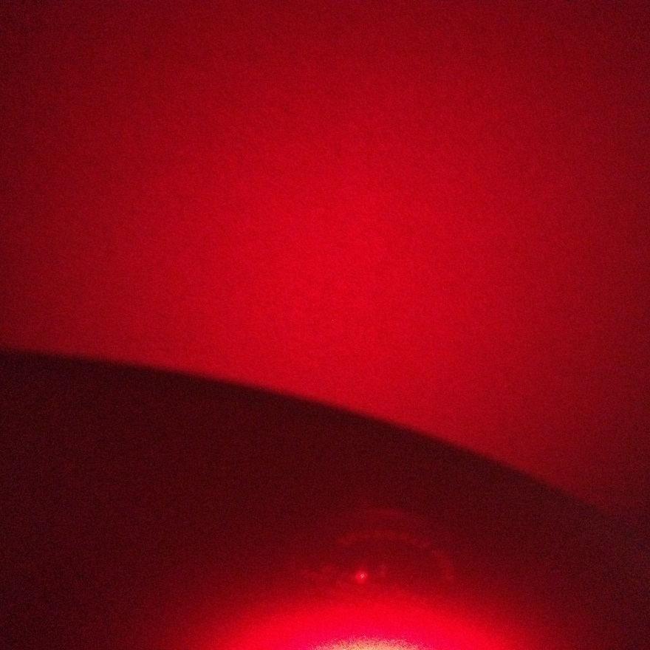
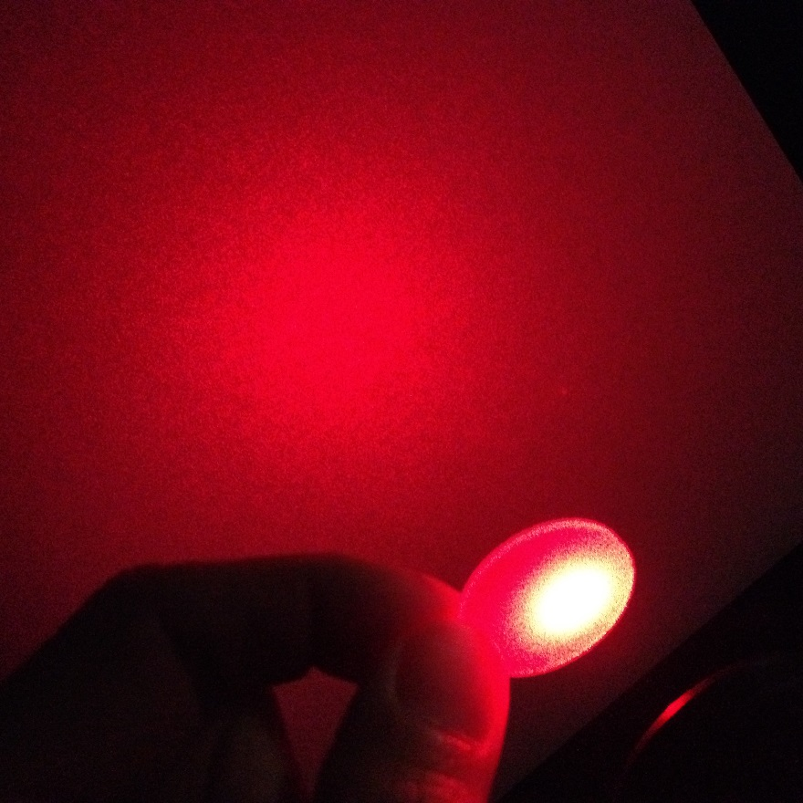
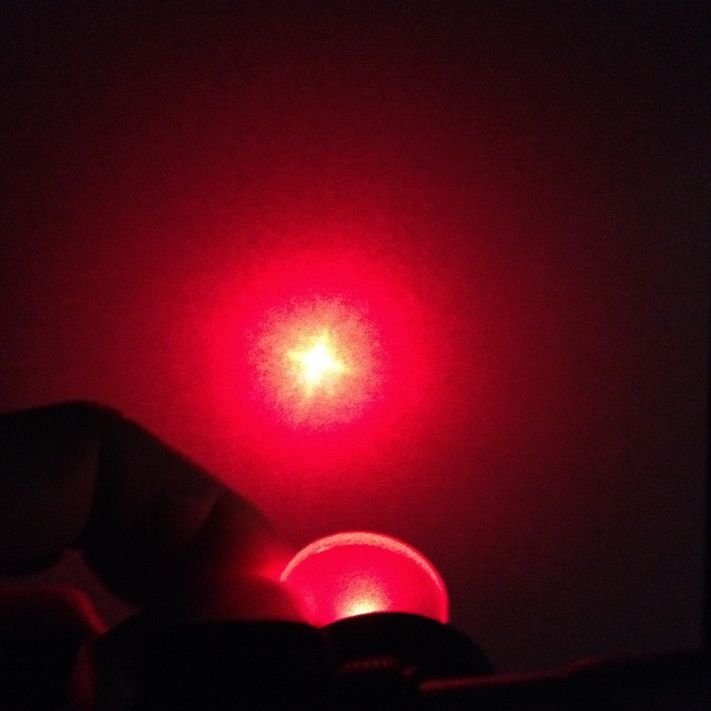
Here is what happens when you put different transmitting diffusers in the beam path of a low power HeNe laser – the spot from the main beam should not be apparent:
Existing plastic diffuser
Ground quartz diffuser
Sample from GM Assoc.

Slide 10
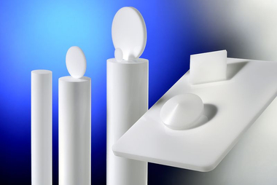
As part of the diffuser search exercise, I learned from my colleague Yuqin Zong of a new processing of fused silica that is very exciting. In this process, ≈3μm gas bubbles are distributed homogeneously in the volume. These act as scattering centers. The material appears opaque and should be very Lambertian. Plus, they are rugged since surface defects or contamination do not affect the scattering. They would work in reflection or transmission. The surface finish can be specified as “honed” or “polished”. The manufacturer is opsira GmbH, Weingarten, Germany. The US distributor is Lambda Research Corporation, Littleton MA.
Diffusil diffusers from opsira, http://www.opsira.de/en/products/diffusil-diffusers.html
This material would seem ideal for space use.
The largest diameter currently achievable is 200 mm. This is smaller than the SQM diffuser, but this diameter would be sufficient for MOBY. We’d need to design and make an adaptor piece to hold it in the SQM.
At the moment, I’m not going with this option (one piece is $1250 plus taxes, fees, shipping, etc.) The delivery is 8 weeks ARO and this is too close to our credit card limit, where we need delivery by mid September for fiscal year end concerns. The adaptor plate could be made during the 8 weeks, so we could be up and running by early Oct. The other reason to defer on the diffusil is that the SQM does not really need a good diffuser, as long as the DUT is mounted kinematically. We do need good transmittance and stability, however.

Slide 11
On July 28, YES (Mark Beaubien) sent a piece of code SERPDRV and I reinstalled SQM Manager, renamed the existing file of this name, and copied the replacement file to the directory. The program now runs, talking to the SQM on COM 0. Mark reported he is still looking for the Labview source code. We need that to find the command set and develop our own logging software, one that incorporates header information and has panels that correspond to the manual operations.
The basic steps I took were
SQM AC power on
Launch program
SQM to Standby
Start data logging (Move the Logging Button UP; not sure when I started this, actually)
SQM to HI
SQM to MED
SQM to LO
SQM to Standby
SQM off
AC off
Exit program (turn the “ON” switch to “OFF”; also not sure exactly in the sequence I did this)

Slide 12
Here is what the first few lines in the file looks like this – the data are logged every 5 sec.
7/28/2015,02:35:10 PM,0.000000 ,0.006010 ,10 ,0.000000 ,0.004635 ,10 ,0.107555 ,0.143508 ,0.216238 ,44.950896 ,26.455657 ,35.041016 ,30.182251 ,
7/28/2015,02:35:37 PM,0.000000 ,0.006025 ,10 ,0.000000 ,0.004628 ,10 ,0.107506 ,0.143422 ,0.216437 ,45.154327 ,26.582458 ,35.034576 ,30.361572 ,
7/28/2015,02:35:40 PM,0.000000 ,0.006014 ,10 ,0.000000 ,0.004683 ,10 ,0.106694 ,0.143418 ,0.215852 ,45.124145 ,26.595153 ,34.865966 ,30.381103 ,
7/28/2015,02:35:45 PM,0.000000 ,0.006021 ,10 ,0.000000 ,0.004644 ,10 ,0.107703 ,0.143336 ,0.215145 ,45.031006 ,26.619018 ,35.117676 ,30.392669 ,
7/28/2015,02:35:50 PM,0.034167 ,0.006007 ,11 ,0.047783 ,0.004679 ,10 ,0.107291 ,0.143513 ,0.216276 ,44.928191 ,26.644653 ,34.916838 ,30.462463 ,
7/28/2015,02:35:55 PM,0.117499 ,0.102914 ,47 ,0.131099 ,0.062310 ,47 ,0.108341 ,0.143610 ,0.217551 ,44.908995 ,26.664611 ,35.093445 ,30.458221 ,
7/28/2015,02:36:00 PM,0.200814 ,0.187752 ,74 ,0.214414 ,0.195096 ,69 ,0.107541 ,0.143572 ,0.215810 ,45.006897 ,26.689818 ,34.973052 ,30.529113 ,
7/28/2015,02:36:05 PM,0.284129 ,0.267607 ,104 ,0.297728 ,0.275764 ,81 ,0.108162 ,0.143494 ,0.217235 ,45.156280 ,26.715331 ,34.955718 ,30.537658 ,
7/28/2015,02:36:10 PM,0.367442 ,0.348297 ,139 ,0.381042 ,0.364096 ,94 ,0.107778 ,0.143839 ,0.217581 ,45.206970 ,26.735503 ,35.015869 ,30.571929 ,
7/28/2015,02:36:15 PM,0.450756 ,0.423811 ,184 ,0.464355 ,0.444704 ,106 ,0.106885 ,0.143162 ,0.216370 ,45.191131 ,26.760070 ,34.901610 ,30.597320 ,
7/28/2015,02:36:20 PM,0.534066 ,0.491767 ,252 ,0.547664 ,0.528646 ,119 ,0.106404 ,0.143218 ,0.213578 ,45.123932 ,26.785216 ,35.101593 ,30.616973 ,
7/28/2015,02:36:25 PM,0.617371 ,0.553846 ,362 ,0.630969 ,0.611959 ,132 ,0.107185 ,0.143569 ,0.216616 ,45.050690 ,26.805144 ,34.874419 ,30.684447 ,
7/28/2015,02:36:30 PM,0.700960 ,0.627602 ,505 ,0.714558 ,0.689277 ,146 ,0.108147 ,0.143762 ,0.215253 ,44.949645 ,26.832030 ,35.132904 ,30.671691 ,
7/28/2015,02:36:35 PM,0.784265 ,0.704941 ,661 ,0.797863 ,0.771041 ,160 ,0.112700 ,0.148257 ,0.217487 ,44.915892 ,26.859160 ,34.882262 ,30.741179 ,
7/28/2015,02:36:40 PM,0.867571 ,0.779823 ,831 ,0.881169 ,0.851010 ,177 ,0.134119 ,0.167979 ,0.224460 ,44.988860 ,26.881804 ,35.130127 ,30.728332 ,
7/28/2015,02:36:45 PM,0.949999 ,0.851336 ,1022 ,0.964474 ,0.931615 ,195 ,0.183775 ,0.205784 ,0.254401 ,45.148651 ,26.912291 ,34.892791 ,30.805388 ,
7/28/2015,02:36:50 PM,0.949999 ,0.897911 ,1170 ,1.047787 ,1.012780 ,215 ,0.233782 ,0.268430 ,0.291501 ,45.237518 ,26.946898 ,35.047089 ,30.778777 ,
7/28/2015,02:36:55 PM,0.949999 ,0.920434 ,1251 ,1.131076 ,1.087885 ,239 ,0.273931 ,0.309508 ,0.330798 ,45.237091 ,26.974883 ,34.901427 ,30.867522 ,
The manual says the columns are (after the date & time stamp):
1A set current; 1A actual current, 1A diagnostic;
3A set current; 3A actual current, 3A diagnostic;
Red PD, Broadband PD, Blue PD;
Shunt temperature, Case temperature, PD temperature.
Questions:
The manual states the shunt temperature is fixed at 45°C and the case at 35°C. I don’t understand how Shunt started at 45°C when the SQM had been off. Also, there are four, not three columns that appear to be temperature data.

Slide 13
HI
MED
LO
Output from the test run of SQM Manager columns 1, 2, 4, & 5. During ramp up, the actual currents lag the set current; during ramp down, the opposite is true. I waited until the case temperature seemed to stabilize before changing states.

Slide 14
Columns 7, 8, & 9 from SQM Manager. The MED level is not very different from HI. Perhaps “Blue” and “Red” are reversed in the manual description, I’d expect the blue signal to be the smallest.
HI
MED
LO
LO
HI
MED
Room lights were on

Slide 15
Columns 10 to 12 from SQM Manager. It looks like 10 and 12 are the Set temperature for the shunt and case temperature control circuits, and that the col 13 temperature had not stabilized during the test.

Slide 16
Zoomed in on HI – The Red is weird, decreases part of the time while the broadband increases
Correlations: I filtered the data set based on the sum of the lamp.
HI: Sum > 3.948 A
MED: 3.005 A < Sum <= 3.007 A
LO: 0.9545 A < Sum <= 0.9551 A
Operationally, such hardwiring may get us into trouble as the SQM currents may drift. The alternative solution is to start a new file. This relies on the Operator being super Human in terms of consistency and log sheets.

Slide 17
Photodiode signals as a function of the sum of the actual lamp currents on both lamp rings
HI
MED
LO

Slide 18
The temperatures varied over a wider range during the HI set vs MED or LO on July 28, 2015. This is apparent in the PD signals.

Slide 19
Summary, July 28 – Aug 4
The SQM works. The % stds were 0.2% (HI, Red) to 0.1% (HI, all three) to 0.6% (LO, blue) for the photodiodes. Temperature stabilization is necessary. Hopefully the unit is made to stabilize without having to run the lamps to heat it up (The NIST/NASA SQM had a preheater).
SQM Tasks:
Decide on Diffuser & make adaptor (for diffusil only) (Team)
Design, build coupler to CAS’ (Carol)
Design, build coupler to MOBY heads kinematic in rotation and distance (Mark Y)
Get YES to deliver code or command set (Mark B)
Write DAQ for SQM in Labview (Tom)
Work with Mike F and Steph to design logsheets
Write analysis in Matlab Mldbase (Steph) and beta test
When the CAS and SQM DAQ and Mldbase are in place, begin series of final testing.

Slide 20
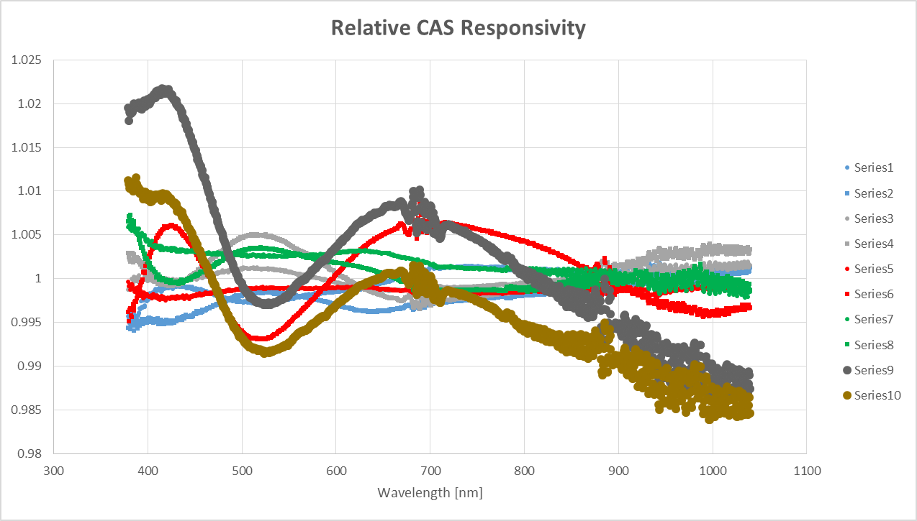
We got the CAS for the radiometer based on tests at NIST with Woodward’s CAS. The stability (left panel, all but the two “outlier” results) looked good at the time of the proposal. Recent work done the same way got series 9 and 10 (left panel), so Howard is doing tests with other lamps (right panel) and Steve and John are looking at the CAS sensitivity to things.
These data, which are repeats on FEL lamps using the CAS cosine collector and fiber bundle, say to me I should set up something similar, or join their “club” and so have a time series on the NET CAS using FELs. The first order of business is to work on the CAS software, we will start in 2 weeks (Tom Larason, Carol, Steph).

